Slide 1

Unit 4: Lesson 2 You’ve just got Banksy-ed

Slide 2
Task 1: Read the statements and say if you agree with them.
I agree / I don’t agree

Slide 3
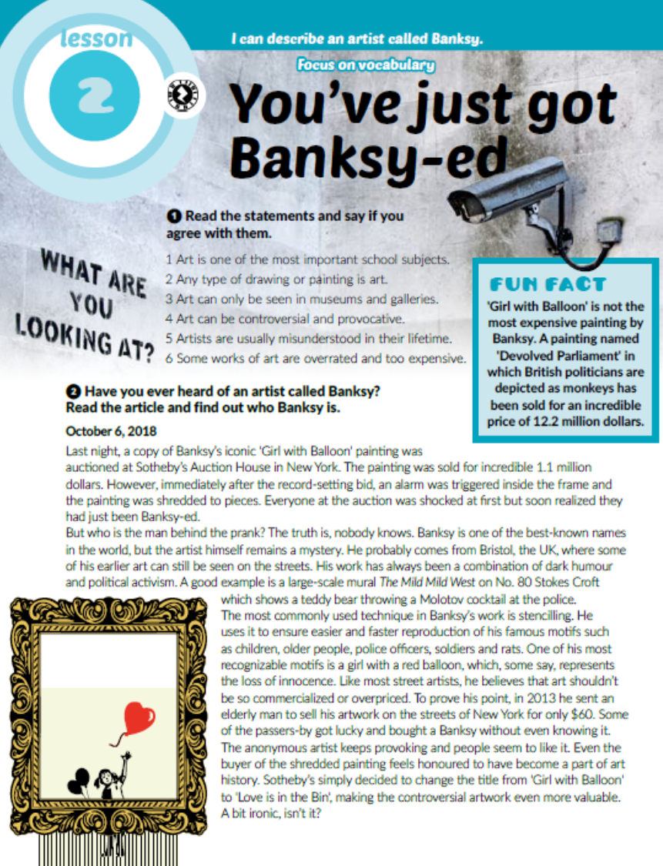
Task 2: Read the article and find out who Banksy is.

Slide 4
Task 3: Which words would you use to describe Banksy?
witty = duhovit
open-minded = otvorenog uma
old-fashioned = staromodan
creative = kreativan
boring = dosadan
unconventional = nekonvencionalan
ambitious = ambiciozan
materialistic = materijalist
talented = nadaren
poor = siromašan
conservative = konzervativan
misunderstood = neshvaćen
controversial = kontroverzan
rebellious = buntovan
original = originalan

Slide 5
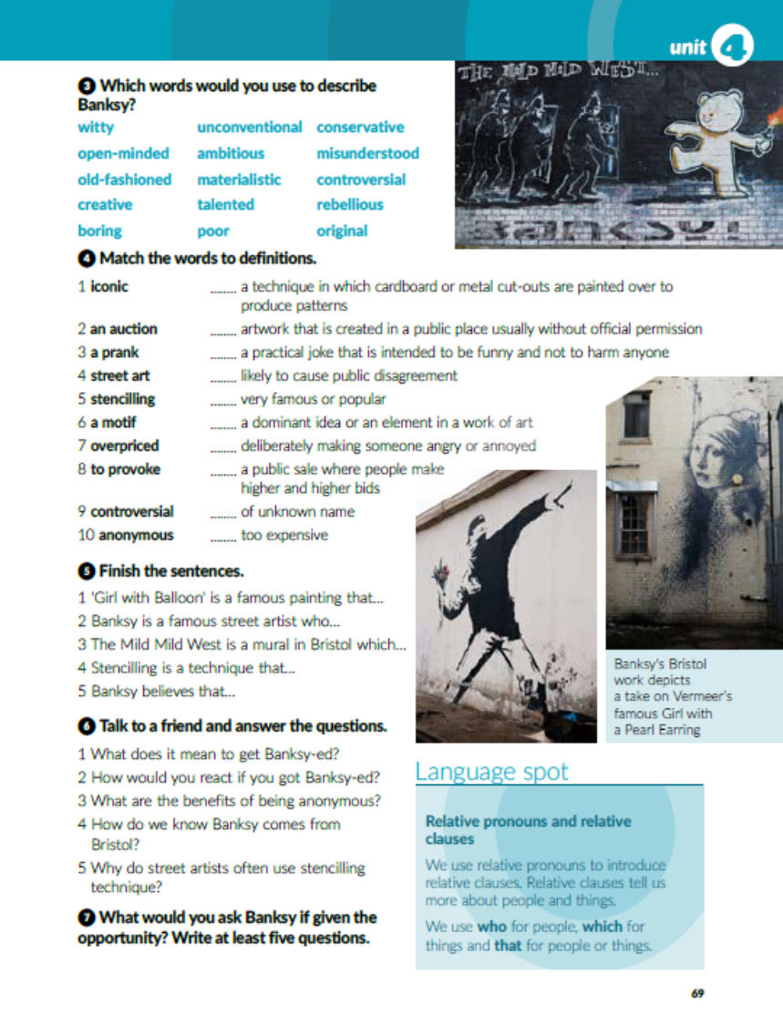
Task 4: Match the words to definitions.
5
4
3
9
1
6
8
2
10
7

Slide 6

Task 5: Finish the sentences.
1 'Girl with Balloon' is a famous painting that was shredded to pieces.
2 Banksy is a famous street artist who probably comes from Bristol, the UK.
3 The Mild Mild West is a mural in Bristol which shows a teddy bear throwing a Molotov cocktail at the police.
4 Stencilling is a technique that ensures easier and faster reproduction.
5 Banksy believes that art shouldn’t be so commercialized or overpriced.

Slide 7
Zapiši u bilježnicu:
Relative clauses
Relative pronouns: who, which, that.
Relative clauses tells us more about people and things.
who – for people
which – for things
that – both people and things

Slide 8

Task 7: What would you ask Banksy if given the opportunity? Write at least five questions.

Slide 9
workbook, page 70
Task 1: Correct the mistakes.
artist
the UK
streets
West
teddy
usually
older
rats
red
innocence
New York
dollars
frame
panting
more

Slide 10
Task 2: Match the opposites.
10
8
5
6
3
4
9
2
7

Slide 11
Task 3: Unscramble the letters.
original
rebellious
materialistic
unconventional
misunderstood
conservative
witty

Slide 12
Task 4: Complete the sentences.
prank
anonymous
mural
motif
iconic
auction
shred
overpriced

Slide 13
Task 5: Connect the sentences using the relative pronouns.
who, which, that.
Amy bought a computer that her friend recommended.
Ian broke a plate which was a wedding present.
My best friend who is a lawyer lives in Scotland.
The fruit that Steve bought is on the table.
The watch that belonged to my grandma got broken.
The customer complained to the manager who was very friendly.
I am reading a book that you gave to me.

Slide 14
Task 6: Which nickname would you give yourself if you were a street artist and why?

Slide 15

PLAY AND LEARN!
https://www.e-sfera.hr/dodatni-digitalni-sadrzaji/fb3aaa81-1a34-4887-b771-8fd568bad1e9/

